Slide 1
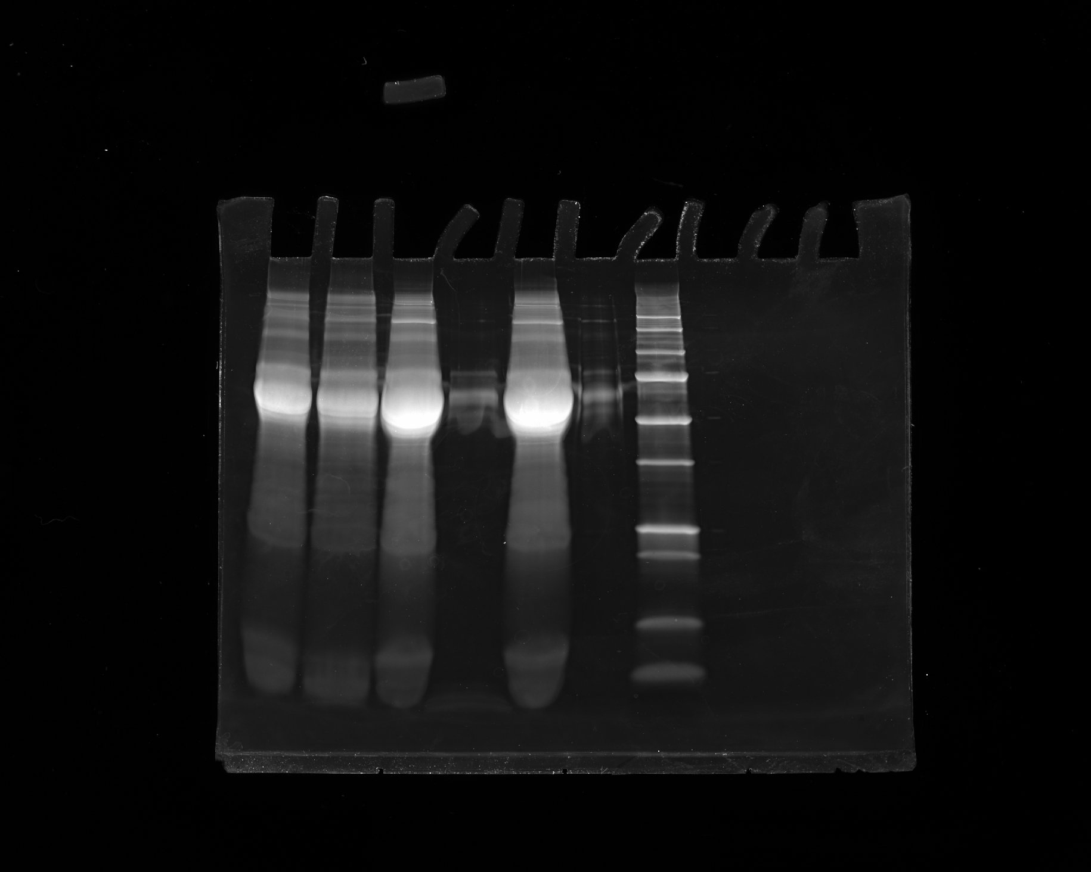
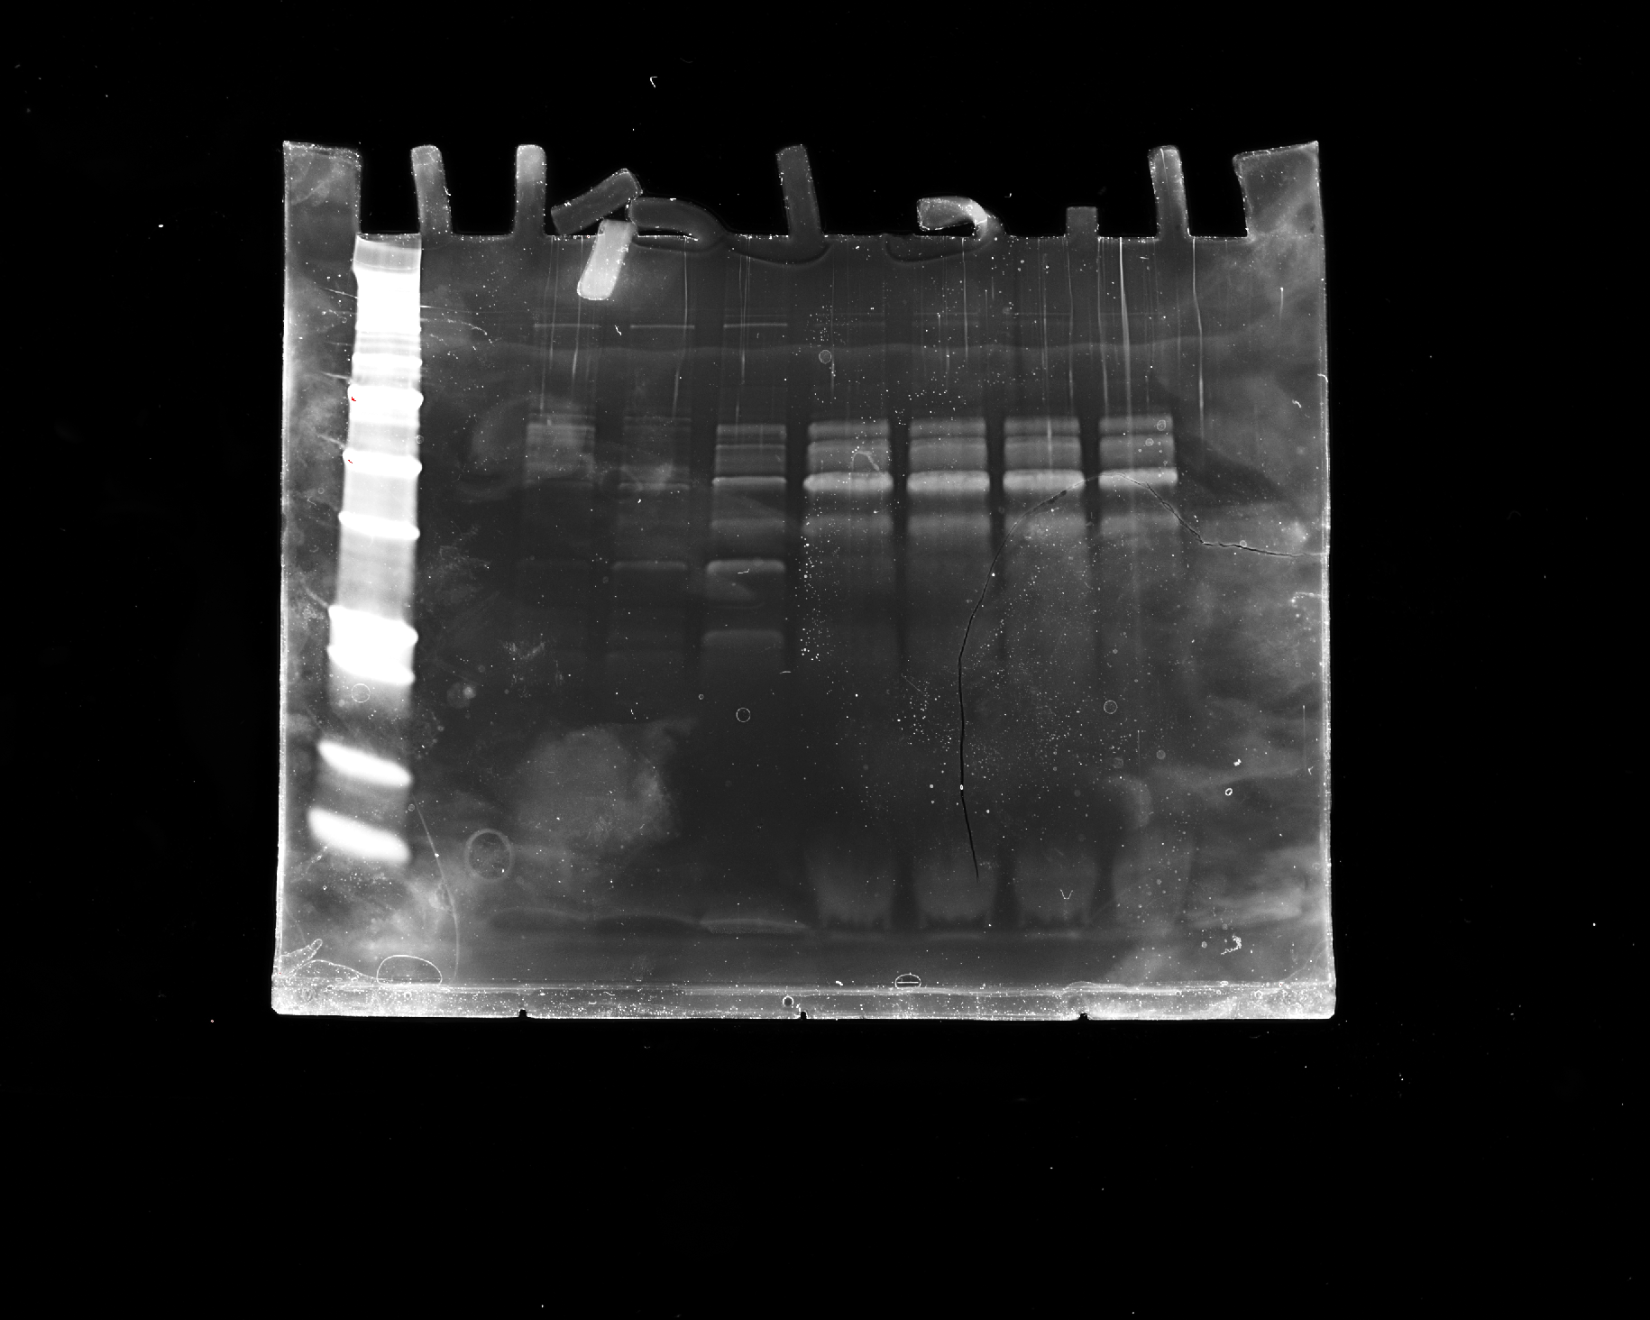
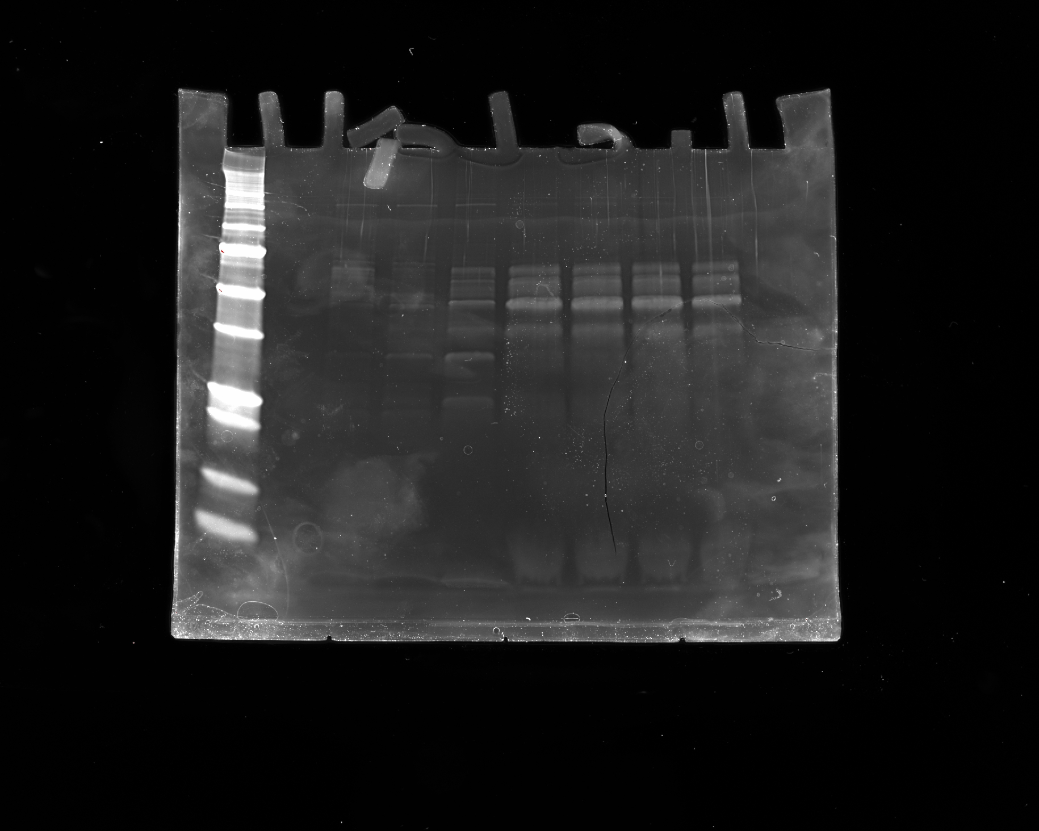
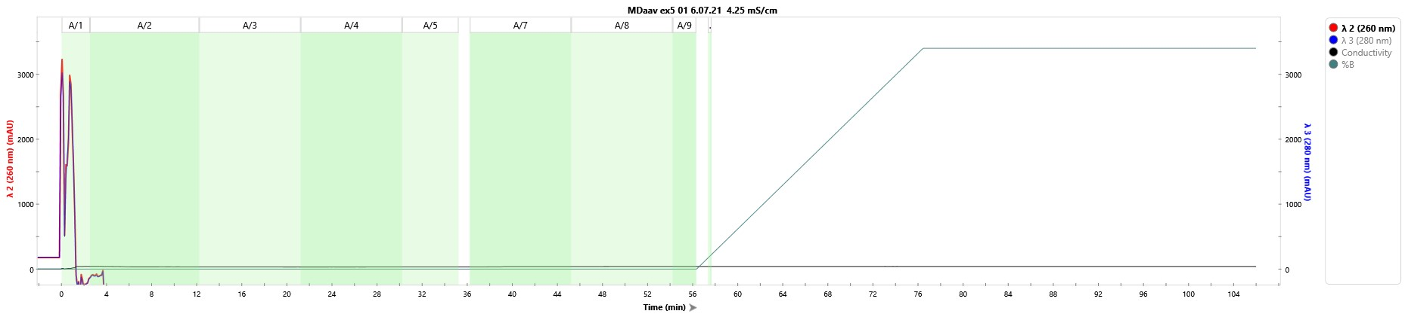
6.7.21 TFF trial
Clarification: Watersep Explorer24 ReUse
Concentration and Diafiltration: TangenX cassettes, 100um, pes, 0. 1m^2
H
S
R
F
P
250 kD
150
100
75
50
37
25
20
FT-1
FT-2
FT-3
FT-4
FT-5
FT-6
FT-7
FT-8
250 kD
150
100
75
50
37
Flow-Through
Sample^{conductivity}- 4.35ms/cm
25
20

Slide 2
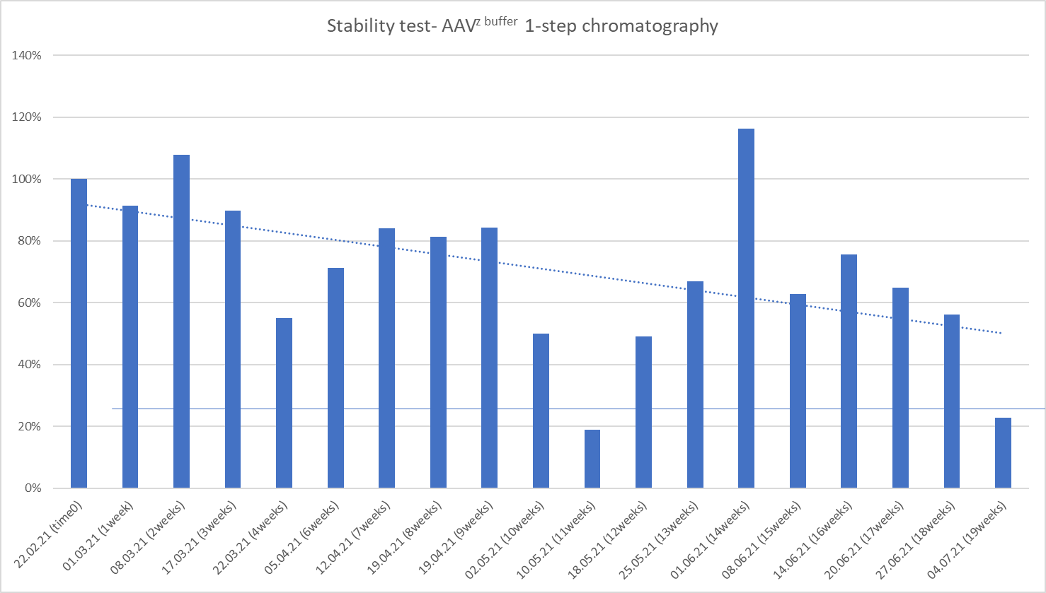
1st month- 10% decrease
2nd month- ~20% decrease
4th month- ~40% decrease
19 weeks- significant loss

Slide 3
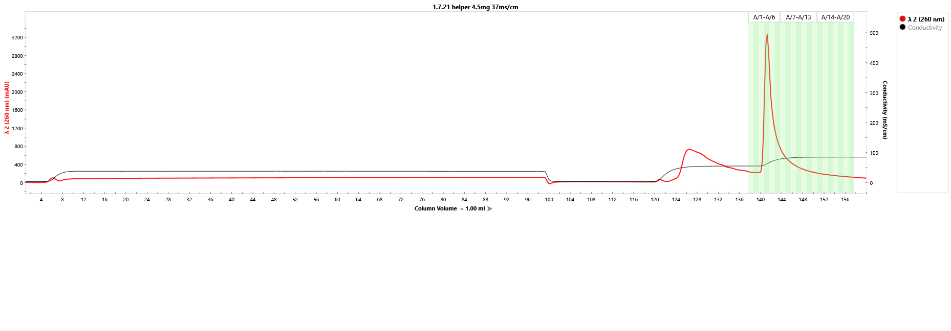
1.07.21 helper plasmid cleaning - DEAE Column 6um, 1ml bed-volume
269
179
Flow-Through
Wash
Elution
Tube # | ng/µl | 260/280
2 | 5.940 | -3.26
3 | 50.617 | 2.09
4 | 268.916 | 2.11
5 | 178.813 | 2.13
6 | 102.779 | 2.21
7 | 73.250 | 2.29
8 | 59.280 | 1.94
9 | 46.132 | 2.40
10 | 37.844 | 2.18
11 | 34.743 | 2.86
50.6
103
73.3
5.9
59.3
37.9
34.7
46.1

Slide 4
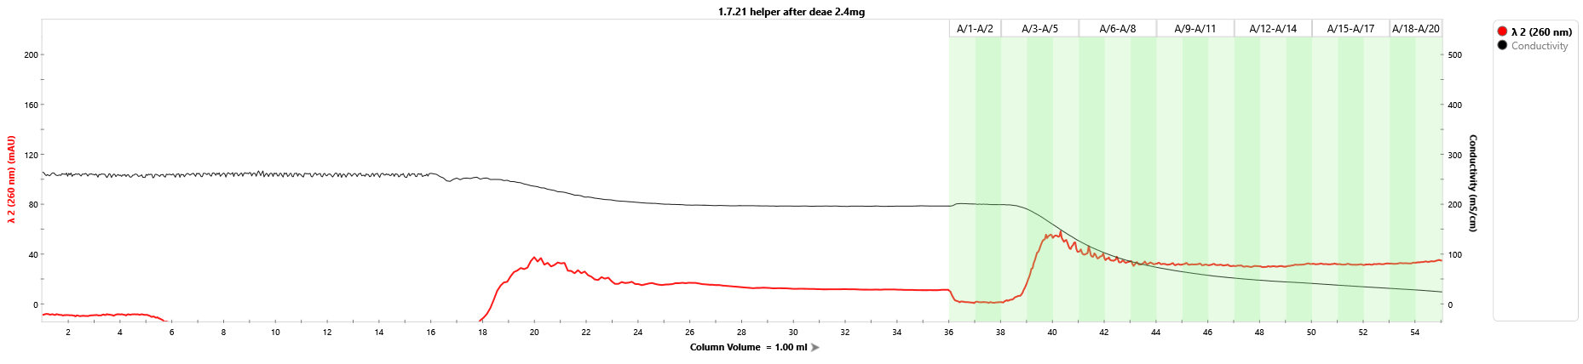
5.07.21 helper plasmid cleaning - C4 HLD Column 2μm, 1ml bed-volume
Flow-Through
Wash
Elution
No product was received (The NanoDrop reads were close to the detection threshold)
Problem with C4 HLD Column; 2um, 1ml bed-volume?
Other Technical problem?

Slide 5
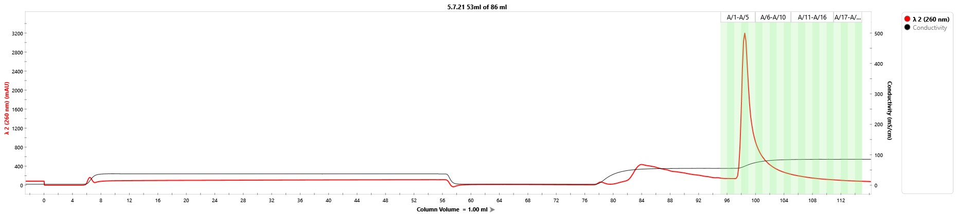
5.07.21 helper plasmid cleaning - DEAE Column 6 μ m, 1ml bed-volume
256
164
Flow-Through
Wash
Elution
Tube # | ng/µl | 260/280
2 | 19.29 | 3.99
3 | 41.13 | 2.87
4 | 256.54 | 2.11
5 | 164.14 | 2.20
6 | 85.29 | 2.32
7 | 57.91 | 2.58
8 | 50.22 | 2.38
9 | 34.82 | 2.85
10 | 35.00 | 2.63
11 | 25.70 | 2.40
41.1
85
57.9
50.2
19.3
34.8
35.0
25.7
In bold - test tubes collected

Slide 6
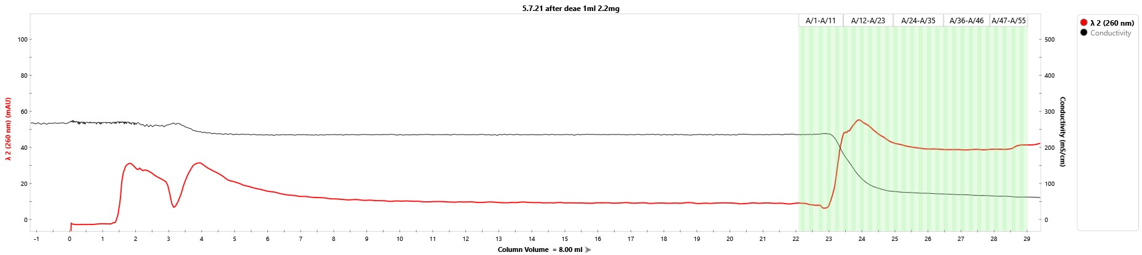
5.07.21 helper plasmid cleaning - C4 HLD Column 2μm, 8ml bed-volume
Flow-Through
Wash
Elution
Sample lost during reformulation
97.6 ng/ul
Total: 0.3 mg

